Slide 1
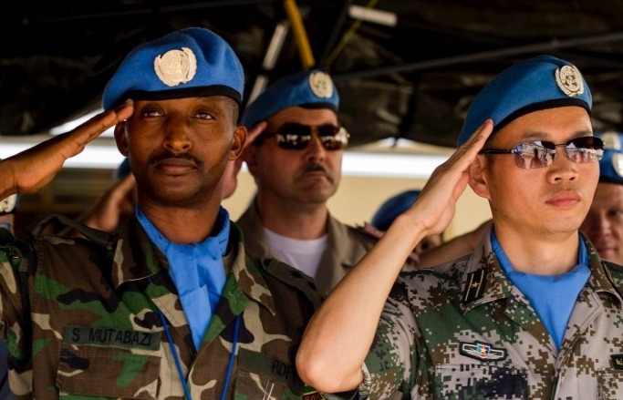
Learning Activity 3.3.1
Image 1
UN Core Pre-Deployment Training Materials 2017

Slide 2
Learning Activity 3.3.1
Image 2
UN Core Pre-Deployment Training Materials 2017

Slide 3
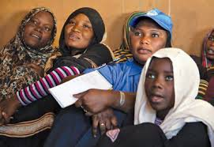
Learning Activity 3.3.1
Image 3
UN Core Pre-Deployment Training Materials 2017

Slide 4
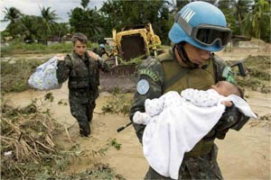
Learning Activity 3.3.1
Image 4
UN Core Pre-Deployment Training Materials 2017

Slide 5
Learning Activity 3.3.1
Image 5
UN Core Pre-Deployment Training Materials 2017

Slide 6
Learning Activity 3.3.1
Image 6
UN Core Pre-Deployment Training Materials 2017

Slide 7
Learning Activity 3.3.1
Image 7
UN Core Pre-Deployment Training Materials 2017

Slide 8
Learning Activity 3.3.1
Image 8
UN Core Pre-Deployment Training Materials 2017

